Slide 1

BINOMIAL THEOREM

Slide 2
OBJECTIVES:
Recognize patterns in binomial expansions.
Evaluate a binomial coefficient.
Expand a binomial raised to a power.
Find a particular term in a binomial expansion.

Slide 3
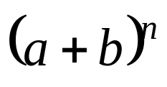
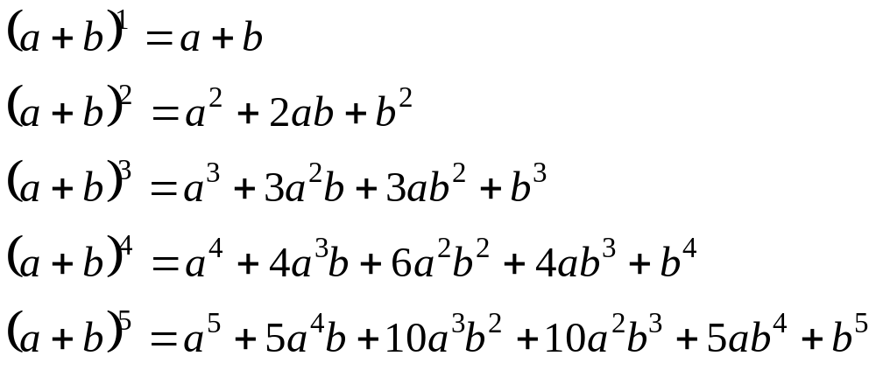
Definition: BINOMIAL THEOREM
Patterns in Binomial Expansions
A number of patterns, as follows, begin to appear when we write the binomial expansion of , where n is a positive integer.
and so on.

Slide 4



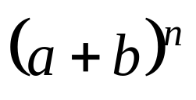
In each expanded form above, the following can be observed:
  The first term is , and the exponent on a decreases by 1 in each successive term.
  The last term is and the exponent on b decreases by 1 in each successive term.
  The sum of the exponents on the variables in any term is equal to n.
  There are terms in the expanded form of .

Slide 5

Definition:
Binomial Coefficients
An interesting pattern for the coefficients in the binomial expansion
can be written in the following triangular arrangement
n = 0 1
n = 1 1 1
n = 2 1 2 1
n = 3 1 3 3 1
n = 4 1 4 6 4 1
n = 5 1 5 10 10 5 1
n = 6 1 6 15 20 15 6 1
This triangular array of coefficients is called the Pascal’s Triangle.
When n is small, the use of Pascal’s triangle is advantageous.
However, if n is large or a specific term is desired, the use of
Binomial Theorem is more appropriate.

Slide 6

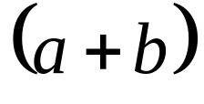
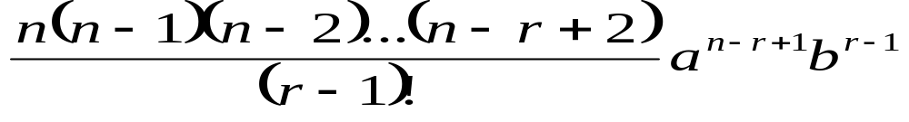
Definition :
THE BINOMIAL THEOREM
The Binomial Theorem provides a formula for expanding expressions of the form , where n is a natural number.
For any binomial and any natural number n ,
The specific term of a binomial expansion is

Slide 7
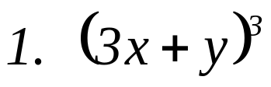
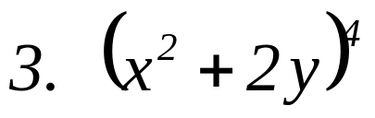
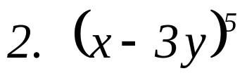
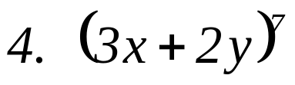
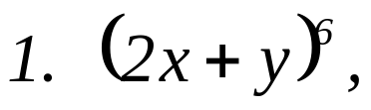
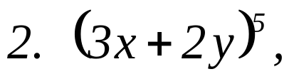
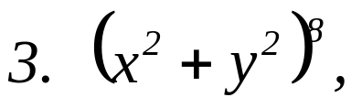
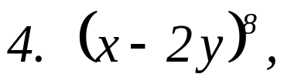
EXAMPLE:
Use Binomial Theorem to expand each binomial and express the result in simplified form.
B. Find the term indicated in each expansion.
3rd term
4th term
4th term
6th term

